Slide 1


Bias Audit Project Presentation
Analyzing fairness and impartiality in systems
Notes:
---

Slide 2
Project Overview
Notes:
---
This slide references information from the following file: https://capeitinitiative-my.sharepoint.com/personal/olwethu_mahlaba_capaciti_org_za/Documents/Microsoft%20Copilot%20Chat%20Files/Group%20Project%20%20Bias%20Audit%20Report.pdf
Objectives and Scope

Slide 3

Objectives and Scope
Project Objectives
  Identify bias in datasets or models and implement fairness metrics to reduce disparities effectively.
Ethical Framework
  Develop an ethics framework linking technical results to real-world impacts and AI fairness principles.
Scope and Deliverables
  Analyze demographics, visualize bias, compare performance, and deliver reproducible notebooks and presentations.
Evaluation Criteria
  Assess technical depth, clarity of visuals, mitigation effectiveness, and accessibility for all audiences.
Notes:
---
This slide references information from the following file: https://capeitinitiative-my.sharepoint.com/personal/olwethu_mahlaba_capaciti_org_za/Documents/Microsoft%20Copilot%20Chat%20Files/Group%20Project%20%20Bias%20Audit%20Report.pdf
The Bias Audit project aims to identify and mitigate bias in a machine learning model using a structured approach. The primary objectives include selecting a dataset or model with potential bias, implementing multiple fairness metrics, and applying mitigation strategies to reduce disparities. This project emphasizes ethical considerations by connecting technical findings to real-world implications and creating a tailored ethics framework. The scope covers demographic analysis, statistical and visual representation of bias patterns, and performance comparison before and after mitigation. Deliverables include a reproducible analysis notebook, a concise presentation, and an ethics statement that aligns with AI fairness principles. The evaluation criteria focus on technical depth, clarity of visualizations, effectiveness of mitigation strategies, and accessibility for both technical and non-technical audiences.

Slide 4
Dataset and Model
Notes:
---
This slide references information from the following file: https://capeitinitiative-my.sharepoint.com/personal/olwethu_mahlaba_capaciti_org_za/Documents/Microsoft%20Copilot%20Chat%20Files/Bias_Audit_Report%20-%20Colab.pdf
Healthcare Dataset and Logistic Regression Model

Slide 5

Healthcare Dataset and Logistic Regression Model
Dataset Features and Target
  The breast cancer dataset includes medical features like radius, texture, and area, classifying malignant or benign cases.
Model Selection
  Logistic regression was selected for its interpretability and effectiveness in binary classification tasks.
Data Preprocessing
  Standard scaling and one-hot encoding were applied for numeric and categorical variables to prepare the data.
Fairness and Evaluation
  Dataset splitting and fairness metrics calculation enabled bias detection across gender groups in the model.
Notes:
---
This slide references information from the following file: https://capeitinitiative-my.sharepoint.com/personal/olwethu_mahlaba_capaciti_org_za/Documents/Microsoft%20Copilot%20Chat%20Files/Bias_Audit_Report%20-%20Colab.pdf
The dataset used in this audit is the Breast Cancer dataset, which was augmented with a gender attribute to simulate demographic variation. This dataset includes features such as mean radius, texture, perimeter, area, and other medical indicators relevant to cancer diagnosis. The target variable represents the classification of malignant versus benign cases. A Logistic Regression model was chosen for its interpretability and suitability for binary classification tasks. The data was preprocessed using standard scaling and one-hot encoding for categorical variables. The dataset was split into training and testing sets to ensure robust evaluation. This setup allowed for the calculation of fairness metrics across gender groups and provided a foundation for bias detection and mitigation strategies.

Slide 6
Bias Findings
Notes:
---
This slide references information from the following file: https://capeitinitiative-my.sharepoint.com/personal/olwethu_mahlaba_capaciti_org_za/Documents/Microsoft%20Copilot%20Chat%20Files/Bias_Audit_Report%20-%20Colab.pdf
Fairness Metrics and Observed Disparities

Slide 7
Fairness Metrics and Observed Disparities
Metric | Value | Interpretation
Statistical Parity Difference | -0.045 | Minor difference in positive classification rates between genders
Disparate Impact | 1.075 | Females slightly favored in positive outcomes
Equal Opportunity Difference | -0.002 | Near parity in true positive rates
Notes:
---
This slide references information from the following file: https://capeitinitiative-my.sharepoint.com/personal/olwethu_mahlaba_capaciti_org_za/Documents/Microsoft%20Copilot%20Chat%20Files/Bias_Audit_Report%20-%20Colab.pdf
The bias audit revealed slight disparities between male and female groups in model predictions. Three key fairness metrics were calculated: Statistical Parity Difference (-0.045), Disparate Impact (1.075), and Equal Opportunity Difference (-0.002). These metrics indicate that while the model performs relatively consistently across genders, there are minor differences in approval rates and true positive rates. Statistical Parity Difference suggests a small gap in positive classification rates, while Disparate Impact shows that females have a slightly higher likelihood of positive outcomes compared to males. Equal Opportunity Difference indicates near parity in true positive rates. These findings highlight the importance of monitoring fairness even when disparities appear minimal, as they can compound in real-world applications.

Slide 8
Visual Representation
Notes:
---
This slide references information from the following file: https://capeitinitiative-my.sharepoint.com/personal/olwethu_mahlaba_capaciti_org_za/Documents/Microsoft%20Copilot%20Chat%20Files/Bias_Audit_Report%20-%20Colab.pdf
Charts Illustrating Bias Patterns

Slide 9
Charts Illustrating Bias Patterns
Approval Rate Comparison
The Approval Rate chart shows the proportion of positive classifications for males and females, indicating a slight advantage for females.
True Positive Rate Analysis
The True Positive Rate chart illustrates the accuracy of positive predictions for each gender, showing near equal results.
Visual Insights for Transparency
Visuals complement statistical metrics to enhance stakeholder understanding and ensure analysis accessibility for all audiences.
Notes:
---
This slide references information from the following file: https://capeitinitiative-my.sharepoint.com/personal/olwethu_mahlaba_capaciti_org_za/Documents/Microsoft%20Copilot%20Chat%20Files/Bias_Audit_Report%20-%20Colab.pdf
Visualizations provide an intuitive understanding of bias patterns across demographic groups. Two key charts were generated: Approval Rate by Gender and True Positive Rate by Gender. The Approval Rate chart compares the proportion of positive classifications for males and females, revealing a slight advantage for females. The True Positive Rate chart examines the accuracy of positive predictions for each gender, showing near parity. These visual insights complement statistical metrics and help stakeholders grasp the practical implications of bias. By presenting these charts alongside numerical results, the analysis ensures transparency and accessibility for diverse audiences, including those without technical backgrounds.

Slide 10
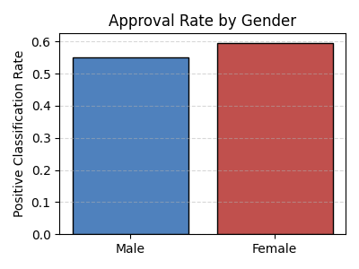
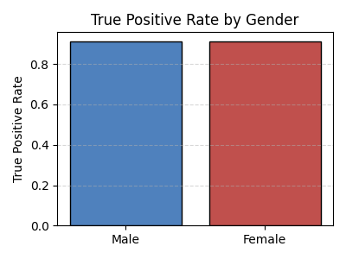

Slide 11
Mitigation Strategies and Performance
Notes:
---
This slide references information from the following file: https://capeitinitiative-my.sharepoint.com/personal/olwethu_mahlaba_capaciti_org_za/Documents/Microsoft%20Copilot%20Chat%20Files/Bias_Audit_Report%20-%20Colab.pdf
Bias Mitigation Techniques and Impact

Slide 12
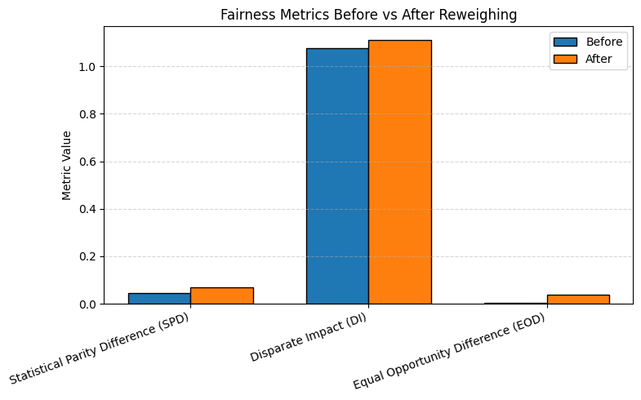
Bias Mitigation Techniques and Impact
Reweighing Technique
  Reweighing adjusts instance weights to balance representation across demographic groups during model training.
Fairness Metrics Improvement
  Fairness metrics showed reduced disparities after applying bias mitigation, while accuracy remained stable.
Importance of Bias Mitigation
  Integrating bias mitigation in machine learning pipelines ensures equitable outcomes without performance loss.
Future Techniques
  Exploring adversarial debiasing and fairness constraints can further enhance bias mitigation effectiveness.
Notes:
---
This slide references information from the following file: https://capeitinitiative-my.sharepoint.com/personal/olwethu_mahlaba_capaciti_org_za/Documents/Microsoft%20Copilot%20Chat%20Files/Bias_Audit_Report%20-%20Colab.pdf
To address observed disparities, the Reweighing technique from the IBM AI Fairness 360 toolkit was applied. This preprocessing method adjusts instance weights to balance representation across demographic groups, reducing bias in model training. After mitigation, fairness metrics were recalculated to assess improvements. While accuracy remained stable, fairness indicators showed reduced disparities, demonstrating the effectiveness of the approach. This step underscores the importance of integrating bias mitigation into the machine learning pipeline, ensuring equitable outcomes without compromising performance. Future enhancements could include exploring additional techniques such as adversarial debiasing or incorporating fairness constraints during model optimization.

Slide 13
Ethical Implications and Recommendations
Notes:
---
This slide references information from the following file: https://capeitinitiative-my.sharepoint.com/personal/olwethu_mahlaba_capaciti_org_za/Documents/Microsoft%20Copilot%20Chat%20Files/Group%20Project%20%20Bias%20Audit%20Report.pdf
Connecting Findings to AI Ethics Principles

Slide 14

Connecting Findings to AI Ethics Principles
Ethical Impact of Bias
  Bias in machine learning causes real-world disadvantages, especially in sensitive domains like healthcare.
Principles of Fairness and Accountability
  The project aligns with fairness, accountability, and transparency by identifying and mitigating bias effectively.
Recommendations for Ethical AI
  Continuous fairness monitoring, diverse demographic data, and stakeholder engagement enhance ethical AI development.
Ethics Framework for AI
  An ethics framework grounded in societal values promotes trust and equity in AI systems tailored to use cases.
Notes:
---
This slide references information from the following file: https://capeitinitiative-my.sharepoint.com/personal/olwethu_mahlaba_capaciti_org_za/Documents/Microsoft%20Copilot%20Chat%20Files/Group%20Project%20%20Bias%20Audit%20Report.pdf
The ethical dimension of bias in machine learning extends beyond technical metrics to real-world consequences. Even minor disparities can lead to systemic disadvantages for certain groups, particularly in sensitive domains like healthcare. This project aligns with principles of fairness, accountability, and transparency by identifying bias, applying mitigation strategies, and communicating findings clearly. Recommendations include continuous monitoring of fairness metrics, incorporating diverse demographic data during model development, and engaging stakeholders in ethical decision-making. Establishing an ethics framework tailored to the use case ensures that technical solutions are grounded in societal values, promoting trust and equity in AI systems.

Slide 15
Conclusion
Notes:
Summary and Future Directions

Slide 16

Summary and Future Directions
Comprehensive Bias Mitigation
  The project uses metrics, visual analysis, and ethics to identify and reduce bias in machine learning models.
Ensuring Fairness and Trust
  Proactive mitigation addresses disparities to ensure fair AI outcomes and build user trust in technology.
Future Research Directions
  Future efforts focus on advanced techniques, broader demographic inclusion, and lifecycle fairness integration.
Ethical AI Development
  Prioritizing ethics alongside technical performance fosters AI solutions that serve all users responsibly.
Notes:
The Bias Audit project demonstrates a comprehensive approach to identifying and mitigating bias in machine learning models. Through quantitative metrics, visual analysis, and ethical reflection, the project highlights the importance of fairness in AI systems. While initial disparities were minor, proactive mitigation ensures equitable outcomes and builds trust in technology. Future work should explore advanced mitigation techniques, expand demographic representation, and integrate fairness considerations throughout the model lifecycle. By prioritizing ethical principles alongside technical performance, organizations can create AI solutions that serve all users fairly and responsibly.

